Slide 1
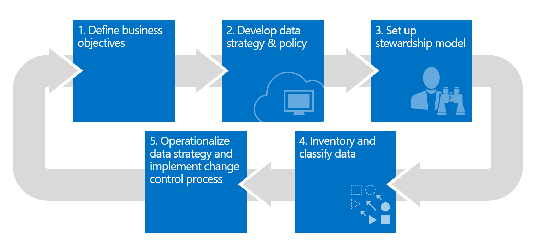
Data Governance Accelerator
John Rampono
Beau Faull

Slide 2

Reimagine
data governance with Microsoft
On-prem
Unified | Hybrid | Open
Multicloud
SaaS

Slide 3
Sensitive Data is at risk
80 %
of employees use non-approved SaaS apps at work
85 %
of enterprise organizations keep sensitive information in the cloud
88 %
of organizations no longer have confidence to detect and prevent loss of sensitive data
58 %
Have accidentally sent sensitive information to the wrong person

Slide 4

Do you have a strategy for protecting and managing sensitive information?
Do you know what sensitive data who have?
Do you know where your sensitive data resides?
Do you have control of your data as it travels inside and outside of your organization?
Are you using multiple solutions to discover, classify, label, and protect sensitive data?

Slide 5




Q: Where is your data? A: Everywhere
Mobile devices
Devices: fixed and mobile
SaaS apps & file shares
On-premises file shares
Cloud storage
SaaS apps
Online backup
Email
On-premises
On-premises

Slide 6
Microsoft enables unified data governance
Reimagine data governance in the cloud
Set the foundation for effective data governance
Maximize business value of data for data consumers
Gain insight into data use across the estate

Slide 7
Data Governance Accelerator
Focus is on three key areas of capability
Discover
Classify
Govern
Accelerated Project that aims to rapidly improve an organisations Data Governance capabilities by implementation, configuration and customisation of Microsoft Data Governance products and services

Slide 8










Data Governance Accelerator Outcomes
Classify
Govern
Information Discovery & Data Catalogue
Metadata Enrichment
Unified Taxomony & Labels
Certification & Promotion
Control & Protect
Auditing & Monitoring
Unified Compliance Reporting
Discover
Information Discovery
Information Classification

Slide 9

Data Governance Accelerator
Comprehensive framework and set of artefacts to rapidly protect and govern your most important data – throughout its lifecycle
Unified approach
Unified approach to discover, classify & label
Automatically apply policy-based actions
Proactive monitoring to identify risks
Broad coverage across locations/data repositories
Discover
Classify
Govern
Classify
Sensitivity
Retention
Encryption
Restrict Access
Watermark
Header/Footer
Retention
Deletion
Records Management
Archiving
Monitor
Sensitive data discovery
Data at risk
Policy violations
Policy recommendations
Proactive alerts

Slide 10
Discover Deliverables
Tenant Settings Review
Setup File Scanner
Setup Purview
Purview <-> MIP Integration
Create AU Gov Data Classification Labels
Configure sensitive information types & classification rules

Slide 11
Classify Deliverables
Content Certification
Power BI Integration
Initial Scan Analysis & Findings
Power BI Enhanced Telemetry
Auto Classify Files/Docs/Emails
Classify Data Lake (automated)
Classify up to 5 databases (automated)
Enable ad-hoc manual labelling

Slide 12
Govern Deliverables
Power BI (PBI) Auditing
Cloud App Security *
MVP Setup Data Loss Protection
Setup Compliance Manager
Enable “pre-canned” reports to solve common business problems
PBI Automation
Workspace creation
Breach of policy alerts
VIP PII data access alerts
Establish Data Stewards
Sensitive Info Types
Labels
Tuned Classifiers and re-scan

Slide 13


Holistic Approach to Data Governance
Data Governance
Microsoft 365
Microsoft Azure, On Premise & Other Cloud
Microsoft Power Platform
Email, Documents, SharePoint etc
Databases, OLTP Systems, Files
Reports, Dashboards, Workspaces
Initiative
Sources
Artefacts
Product
Microsoft Information
Protection
Azure Purview
Power BI

Slide 14







Data Governance Accelerator Outcomes
Information Discovery
Information Classification
Compliance Reporting
Information Discovery & Data Catalogue
Information Classification
Metadata Enrichment
Microsoft Information Protection Integration
Microsoft Information Protection
Azure Purview
Azure Data Platform
Power BI
Integration
Feature Extensions
Automation
Certification & Promotion
Control & Standardisation
Auditing & Monitoring
Microsoft Information Protection Integration
Azure Purview Integration

Slide 15
Power BI Deliverables
Tenant Settings Review
Microsoft Information Protection Integration
Cloud App Security Integration*
Intune Integration*
Content Certification
Power BI Enhanced Telemetry
Power BI Auditing
Automation
Workspace creation
Breach of policy alerts

Slide 16
Azure Purview Deliverables
Purview MVP Implementation
Set up automated source system scans
Power BI Integration
Initial Scan Analysis & Findings
Set up of region-specific classification rules
Microsoft Information protection integration

Slide 17
Microsoft Information Protection Deliverables
MVP Set Up – Sensitivity Labels
MVP Set Up – Data Classification
MVP Set Up - Cloud App Security *
MVP Setup – Data Loss Protection
Install and Configure Compliance Manager

Slide 18
Azure Data Platform Deliverables
Power BI Enhanced Telemetry
Power BI Auditing
Automation
Automated Workspace creation
Breach of policy alerts
Extends telemetry capture beyond the standard 7 days
Extends Power BI capability to allow auditing of data displayed in Power BI reports.
Provides transformed & optimised reporting model
Provides “pre-canned” reports to solve common business problems
VIP PII data access alerts

Slide 19
Partner Facing Content

Slide 20
Deliverables in Detail

Slide 21
Power BI Deliverables in Detail
Power BI Tenant Settings Review
Integration of Power BI and Intune
Integration of Microsoft Information Protection and Power BI
Turn on Microsoft Information Protection in Power BI tenant settings
Set up of Protection Metrics Report
Integration of Cloud App Security and Power BI
Using Microsoft Cloud App Security controls in Power BI - Power BI | Microsoft Docs
Microsoft Information Protection sensitivity labels in Power BI - Power BI | Microsoft Docs
Data protection metrics report - Power BI | Microsoft Docs
Configure mobile apps with Microsoft Intune - Power BI | Microsoft Docs
Tenant settings guidance - Power BI | Microsoft Docs
Enable content certification on the Power BI Tenant
Identify Client Certification Team in client organisation
Create certification process and set up web page to present certification process instructions
Update Power BI tenant setting to allow certification and present certification instructions
https://docs.microsoft.com/en-us/power-bi/admin/service-admin-setup-certification#set-up-certification
Power BI Enhanced Telemetry & Usage (Feature Extension)
See Power BI – Enhanced Telemetry & Usage
Power BI Auditing (Feature Extension)
See slide Power BI – Auditing Extension
Power BI Automation & Workflows (Feature Extension)
See slide Power BI Automation: Alerts & Power BI Automation: Workspace Creation

Slide 22
Power BI Deliverables in Detail
Power BI Tenant Settings Review
Tenant settings guidance - Power BI | Microsoft Docs
Integration of Power BI and Intune
Configure mobile apps with Microsoft Intune - Power BI | Microsoft Docs
Integration of Microsoft Information Protection and Power BI
Turn on Microsoft Information Protection in Power BI tenant settings
Set up of Protection Metrics Report
Microsoft Information Protection sensitivity labels in Power BI - Power BI | Microsoft Docs
Data protection metrics report - Power BI | Microsoft Docs
Integration of Cloud App Security and Power BI
Using Microsoft Cloud App Security controls in Power BI - Power BI | Microsoft Docs
Enable content certification on the Power BI Tenant
Identify Client Certification Team in client organisation
Create certification process and set up web page to present certification process instructions
Update Power BI tenant setting to allow certification and present certification instructions
https://docs.microsoft.com/en-us/power-bi/admin/service-admin-setup-certification#set-up-certification
Power BI Enhanced Telemetry & Usage (Feature Extension)
See Power BI – Enhanced Telemetry & Usage
Power BI Auditing (Feature Extension)
See slide Power BI – Auditing Extension
Power BI Automation & Workflows (Feature Extension)
See slide Power BI Automation: Alerts & Power BI Automation: Workspace Creation

Slide 23




Power BI – Enhanced Telemetry & Usage
Azure Function to Regularly Extract Power BI Usage and Telemetry Data
Power BI Admin API
Power BI Admins
PBI Telemetry & Usage Data in Data Lake
Azure Synapse Transformed & Modeled Data
Power BI Usage & Telemetry
Reports
Example of Reports to Be Provided:
Detailed List of Power BI Workspaces, Reports, Dashboards etc
Usage Report: Views of Workspaces, Reports, Dashboards by Time, Department etc
Access Report: Who has been granted access to Workspaces, Reports, Dashboards
External Sharing Report: All content that is shared externally via all of the various external sharing methods.
Stale access report: Users that have access to workspaces / reports but have not accessed the content in X number of days. (X should be configurable)
Most Used Reports / Workspaces
Stale Reports / Workspaces – No views in X number of days
Security & Governance Admins

Slide 24


Power BI – Auditing Extension
Power BI Service
Power BI
Auditor
User’s
Browser
Internal or External Users
Allows obfuscation & or recording (auditing) of data access relating to highly sensitive datasets.
Provides a “curated” user experience
Improves and enhances security
Allows “Role” reuse across Power BI models
Can also provide external user access and non-authenticated (public access)
PBI Auditing Data in Data Lake
Audit Admin’s
Azure Synapse Transformed & Modeled Data
Power BI
Reports

Slide 25




Power BI Automation: Workspace Creation
User requests
workspace
Create Workspace & Assign Security Groups
Create Security Groups
Azure AD Via Graph API
Azure Function for Creation of Workspaces & Associated Security Groups
Power BI Admin API
Applies governance and control to the Workspace creation process. Standardises the access control methods for workspace content using auto-created resource groups.
Notify Admins
Provide User with
Usage instructions
SMTP Server
SMTP Server
*Manual ability for users to create workspaces must be turned off at tenant level
https://docs.microsoft.com/en-us/power-bi/guidance/admin-tenant-settings#create-workspaces

Slide 26


Power BI Automation: Alerts
PBI Telemetry & Usage Data in Data Lake
PBI Auditing Data in Data Lake
Provides alerts to both users & admins when various rules / policies are breached.
E.g.
Sharing Policy Breached
Content Shared / Published to Personal Workspaces
Stale Content Alert
Security Group Policy Breach
Evaluates incoming Power BI Data Against Alert Ruleset
Alert Contacts notified when rules are breached

Slide 27
Azure Purview Deliverables in Detail
Initial Implementation of Purview Service (Production & Non-Production)
Configuration of Purview to periodically scan 5 source systems using the standard Purview data connectors
Integration of Purview and Power BI (Configuration of Purview to periodically scan corporate Power BI environment)
Set up of region-specific classification rules based on standard, localised, Australian template (Partner Provided)
Integration of Purview and Office 365 Sensitivity Labels
Presentation of Initial Scan Findings to client stakeholder group

Slide 28




Purview Extensions:
Accelerated Deployment Flow
Enhanced Feature Flow
Purview Catalog
Grant RBAC
Deploy Services
Extract Reporting
Data
Purview API
Azure Rest API
Set Defaults
Deploy Classification Rules, Scans, Glossary
Purview Reporting App
Purview Automation Functions
Purview
CICD
Purview Reporting Database
Purview Reporting Data
Client Repository

Slide 29
Microsoft Information Protection Deliverables in Detail
Customisation of the Standard Classification Scheme to meet client requirements
Configuration of an Office 365 DLP scheme
Automatically apply a sensitivity label to content in Microsoft 365 - Microsoft 365 Compliance | Microsoft Docs
Learn about data classification - Microsoft 365 Compliance | Microsoft Docs
Create and publish sensitivity labels - Microsoft 365 Compliance | Microsoft Docs
Implementation of a standard, localised, Australian Classification Scheme (Partner Provided)
Templates should be aligned with relevant, local standards e.g. Aus Govt & ISO
Initial Setup and Configuration of Compliance Manager
Microsoft Compliance Manager - Microsoft 365 Compliance | Microsoft Docs
Microsoft Compliance Manager quickstart guide - Microsoft 365 Compliance | Microsoft Docs
Plan for data loss prevention - Microsoft 365 Compliance | Microsoft Docs
Create, test, and tune a DLP policy - Microsoft 365 Compliance | Microsoft Docs

Slide 30
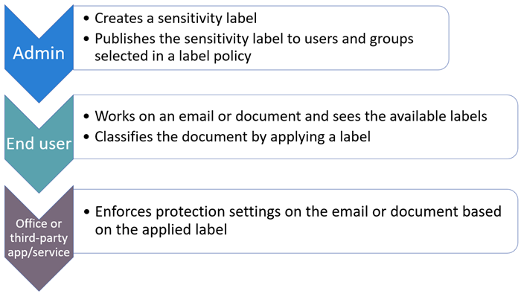
Microsoft Information Protection: Sensitivity Labels
Applies protective controls based on the label policy:
Encrypt the file for specific user/group access
Prevent the file from being stored locally or shared externally
Apply document marking to display information within the document

Slide 31
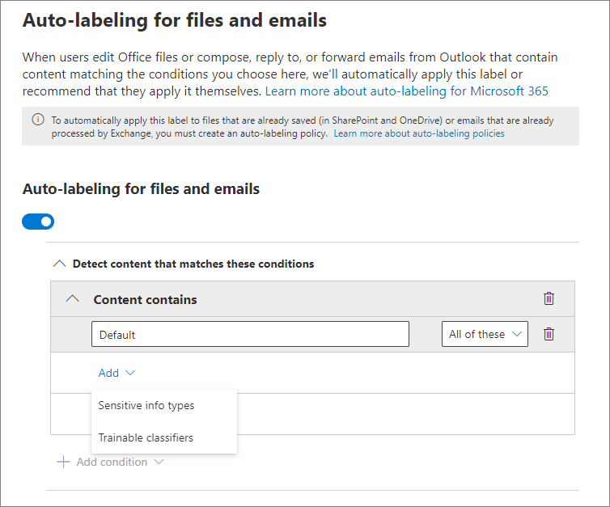
Microsoft Information Protection: Automatic Label Application
Sensitivity Labels to be applied to content automatically based on:
Sensitive Information Types
Trainable Classifiers
Policy rules based on target location: Exchange, SharePoint for example

Slide 32
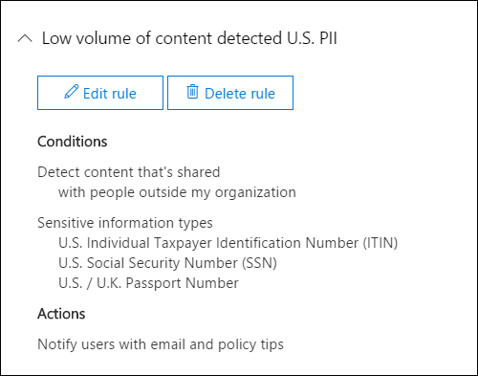
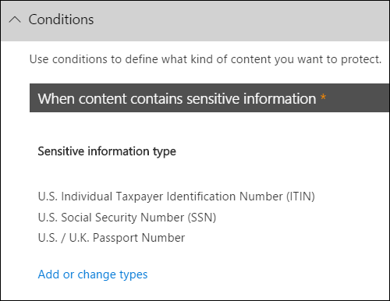
Microsoft Information Protection: Data Loss Prevention
Protect Sensitive data and reduce risk by preventing unauthorised information from being shared.
Content can be searched for by:
Keywords
Regular Expressions
Sensitive Information Types
Sensitivity Labels

Slide 33
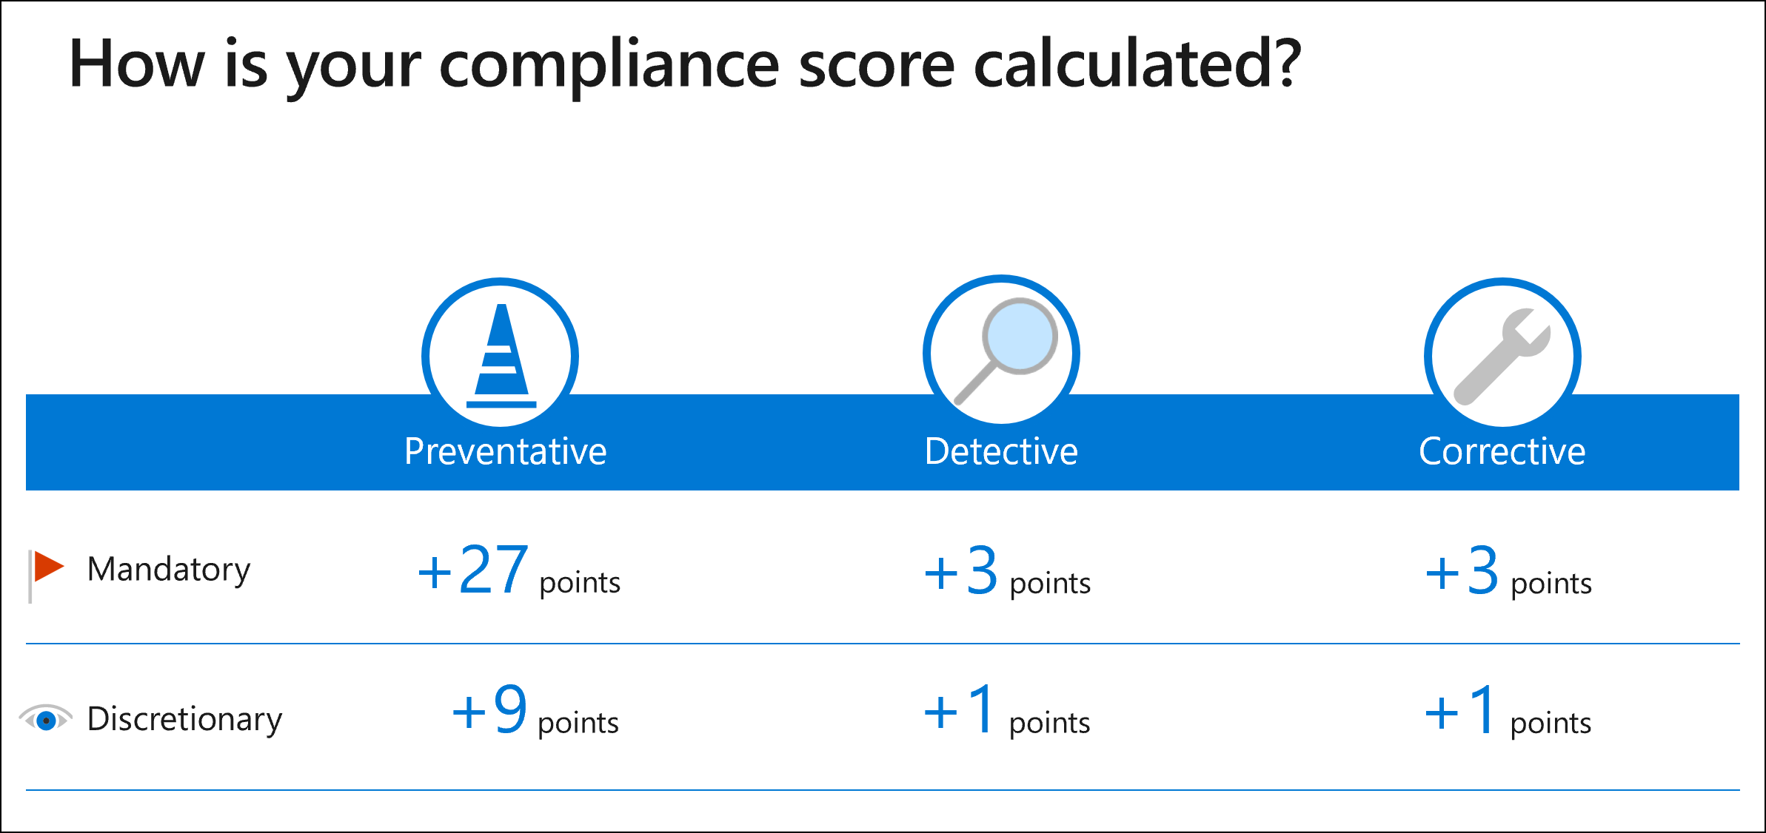
Compliance Manager
Use built-in templates to help manage compliance requirements based on industry and regulatory standards and regulations.
Takes an inventory of data protection risks and provides recommendation on resolving compliance breaches.
Stays current with changes to regulations and certifications, and can provide compliance reports to auditors.

Slide 34
GitHub Repository
https://github.com/microsoft/microsoft-data-governance-accelerator

